Slide 1
Applied Data Science Portfolio
Mark Gopani
SUID 726681243

Slide 2
The Problem
Airlines Review Analysis | IST-707 Applied Machine Learning | Python, Orange3
Find any patterns between the country of the reviewer, type of traveller, cabin flown and overall rating.
Make predictions for recommendations with respect to customer reviews and rating scores of various factors like value for money, seat rating, etc.
Text mining analysis on customer reviews to further predict whether a flight is recommended or not.
Unearthing patterns in reviews such as which words or terms have occurred most in negative reviews leading to a flight not being recommended.

Slide 3
The Data
The dataset is scraped from Skytrax (https://www.airlinequality.com), an international air transport rating organization based in the UK, whose mission is to improve the customer experience for airlines and airports across the world.
Data includes airline reviews from 2006 to 2019 for popular airlines around the world.
Total Columns:20 Total Rows: 41396
Categorical Features: airline, traveller_type, cabin, date_flown.
Numerical Features: overall, seat_comfort, cabin_service, food_bev, entertainment, ground_service, value_for_money.
Target Feature: recommended.

Slide 4
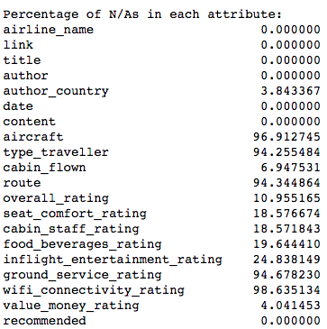
Data Preprocessing
Removed Features with extremely large proportion of NA values
Removed Features unrelated to analysis model, that we won’t be using anyway.
Variables like wifi rating and inflight entertainment rating is missing for many flights and can be used as a feature.

Slide 5
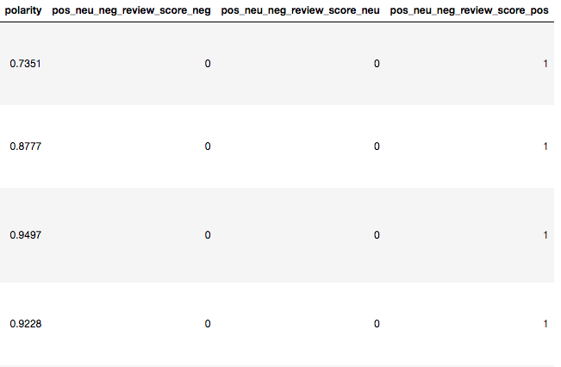
Data Preprocessing
VADER was the open-source sentiment analysis package that was used from nltk. It gave us a polarity score for each review.
The output of the sentiment analysis is a series of scores, namely "compound", "pos", "neu" and "neg". The compound score is normalized between -1 (extremely negative) and 1 (extremely positive).
We classified the overall rating into one of the 3 categories: Positive, Neutral and Negative and add it as another attribute in our data frame. We then create a two dummy variables to use this attribute in our linear regression model.

Slide 6
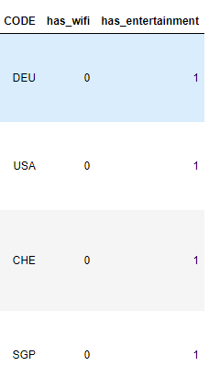
Feature Engineering
We introduce a new column named CODE which contains the three letter codes of the country name fetched from column ‘author country’.
We create two new columns with binary values for having (1) and not having (0) wi-fi and inflight entertainment. Rows which have missing values get assigned a value of 0 while the rest are assigned a value of 1.

Slide 7
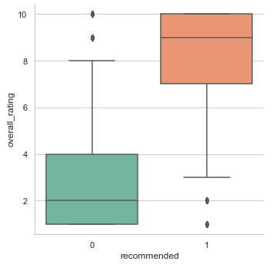
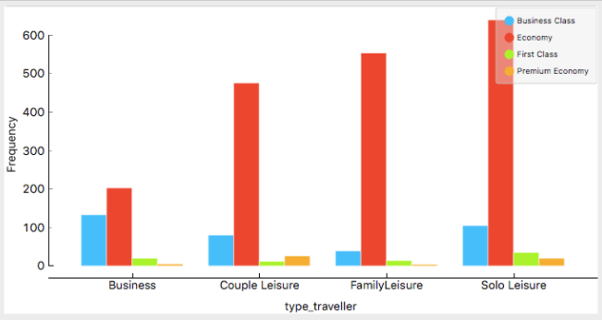
EDA

Slide 8
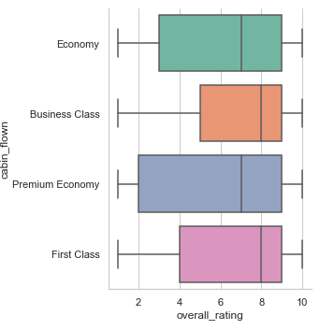
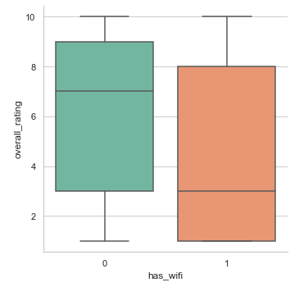
EDA

Slide 9
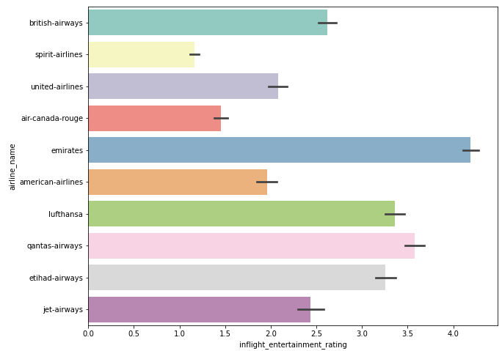
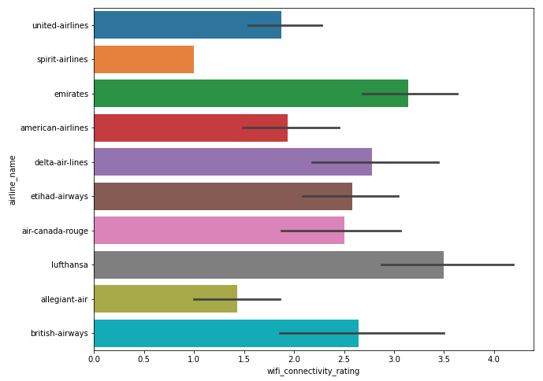
EDA

Slide 10
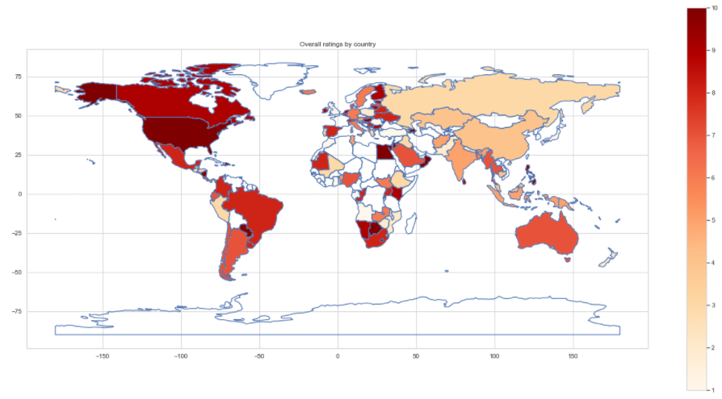
EDA

Slide 11
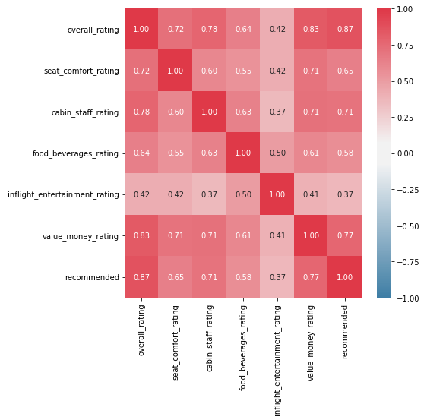
Correlations
Overall_rating has the strongest correlation with recommended.
Inflight_entertainment_rating shows weakest correlation, however we also observed that it had the highest number of NA values.

Slide 12
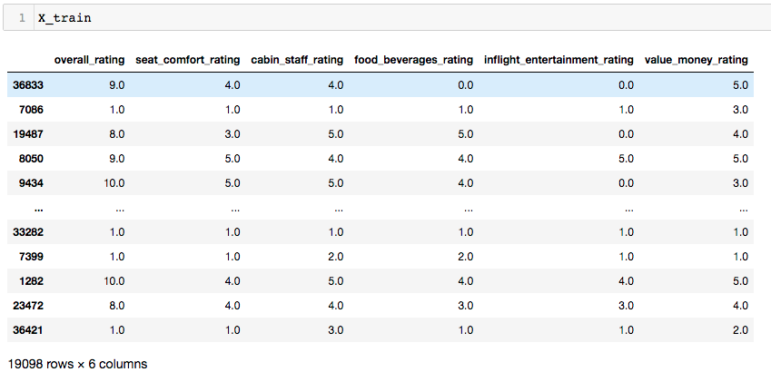
Approach
Splitting data into Train and Test data (70 -30)
Based on the customer reviews under seat_comfort, cabin_service, food_bev, entertainment, ground_service, value_for_money, we predict whether the flight was recommended or not.
Overall rating was not used as a predictor since it is highly correlated with the recommened variable.

Slide 13
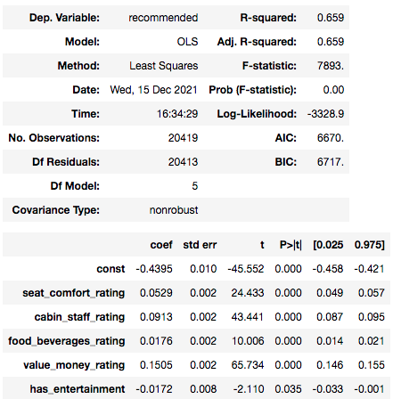
Linear Regression
We have used sklearn and statmodels package in python to create the multiple linear regression model.
The adjusted R-squared of the model is 0.659 which means the independent variables are 66% accurate at predicting the outcome variable value.
All the predictor variables are statistically significant for the model.

Slide 14
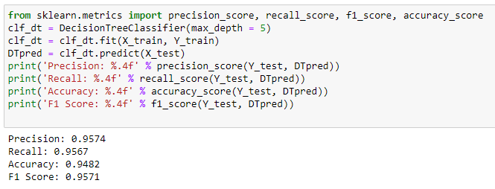
Decision Tree
Same parameters were used to train the Decision Tree.
The parameters such as maximum tree depth was tuned to improve the model.
Increasing maximum depth to 5, increased the accuracy to 94.82% and the F1 Score to 0.9571.

Slide 15
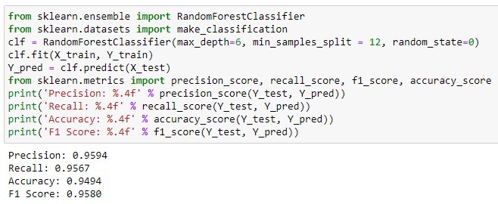
Random Forest Classification
The Random Forest classifier performed slightly better than the Decision Tree.
We increased the accuracy by increasing the maximum depth to 6, but further increase was not making any difference.
The minimum samples split was first kept at 10. Increasing it to more than 15 was degrading the model, so we selected 12 because it was giving a higher precision at the same accuracy.

Slide 16
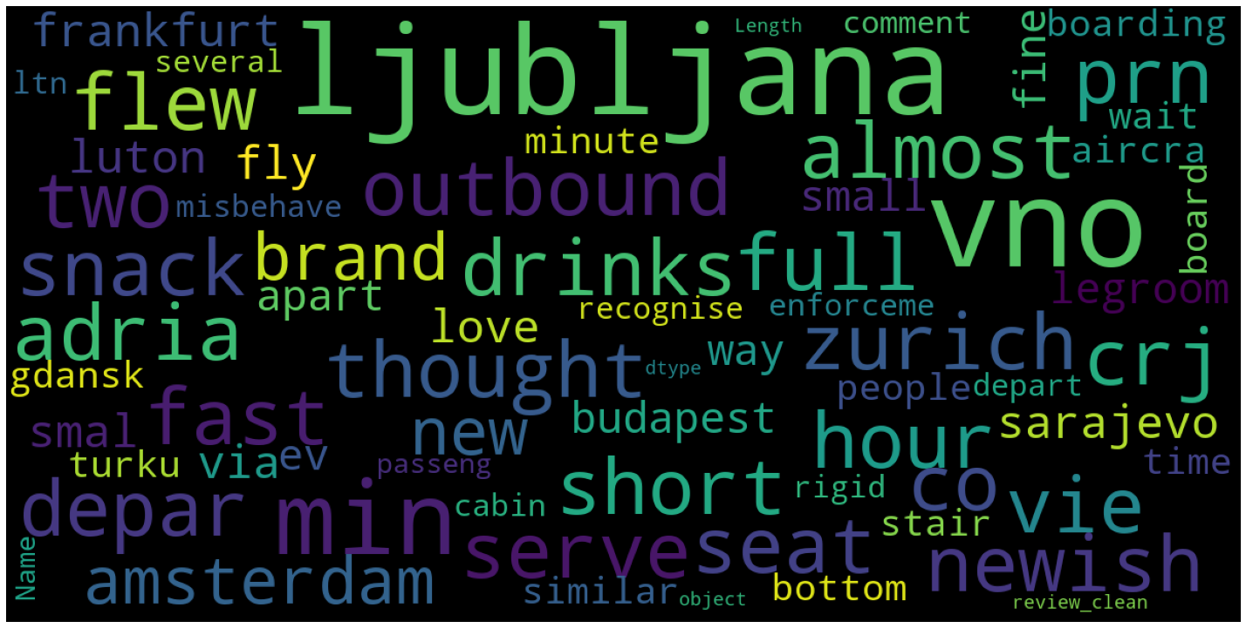
Word cloud – Positive reviews

Slide 17
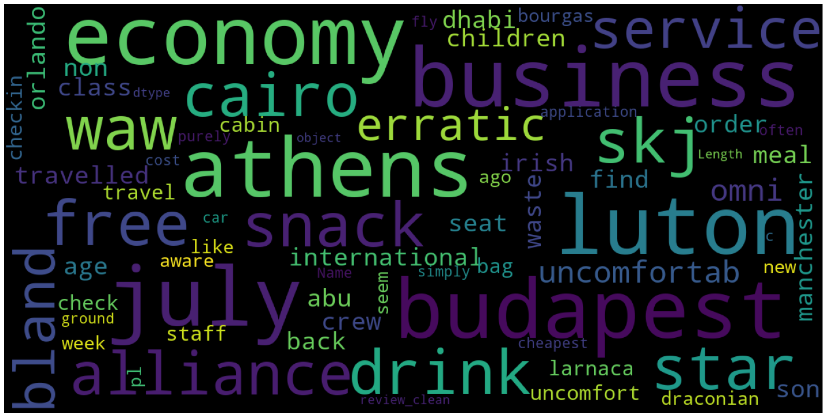
Word cloud – Negative reviews

Slide 18
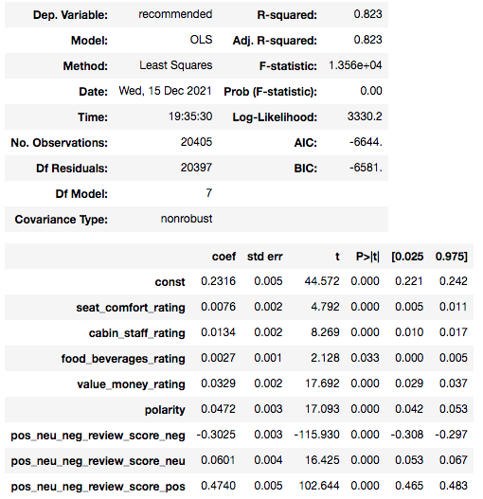
Models using additional predictors
We then run the models with our added features.
The predictors used in the new models included the compound polarity score and the overall rating was broken down into 3 factors to be used with the model.
Accuracy and F1 score of the models have increased after using these scores in the models. They are significant predictors of the recommended variable.
The R-squared has increased from 0.659 to 0.823 indicating that the added features give a better result.

Slide 19
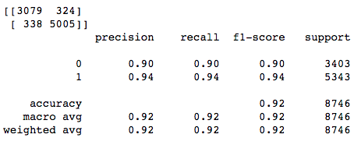
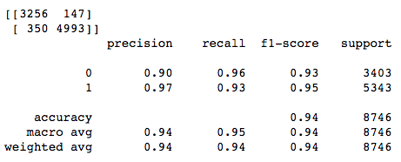
Models using additional predictors
The Decision Tree and Random Forest algorithms also perform better with the additional predictors added.
This shows that using polarity scores and sentiments in the prediction whether a flight is recommended is indeed useful.

Slide 20
Project Overview & Goal
House Price Prediction | IST- 718 Big Data Analysis | Python
The data is from a 1990 census of houses in a certain district in California.
To find out relationships between factors that influence the house price in the block .

Slide 21
the Dataset
The dataset has 20,640 observations of different block groups with 9 variables:
Longitude: refers to the angular distance of a geographic place north or south of the earth’s equator for each block group
Latitude : refers to the angular distance of a geographic place east or west of the earth’s equator for each block group
Housing Median Age: is the median age of the people that belong to a block group. Note that the median is the value that lies at the midpoint of a frequency distribution of observed values
Total Rooms: is the total number of rooms in the houses per block group
Total Bedrooms: is the total number of bedrooms in the houses per block group
Population: is the number of inhabitants of a block group
Households: refers to units of houses and their occupants per block group
Median Income: is used to register the median income of people that belong to a block group
Median House Value: is the dependent variable and refers to the median house value per block group
The way this is written it seems like we are counting all bedrooms across all houses in a block group - which doesn't seem right.

Slide 22

Prediction & Inference Goals
Inference
Which variables are most influential on median home price? i.e. how much does median home price change with a change in each variable?
Does the impact of median income on median home value remain relatively constant throughout the dataset, or are their outliers? What might those outliers tell us?
What is the influence on median home value of the interaction between population and total rooms ? Do home values tend to be higher where populations are more concentrated?
Is there a positive correlation between the number of non-bedroom rooms and median home value?
If we partition the dataset between urban and rural locations, do our relationships hold true? Is this a potential confounding variable, or is its influence already captured by the existing variables?
Predictions
Given the other variables present in the dataset, can we predict the price of an unseen home?
Can we generate a relatively reliable prediction of home value given only longitude, latitude, total rooms, and total bedrooms?
Can we use median age to help predict housing prices on its own?

Slide 23
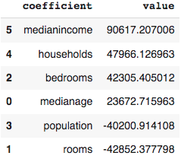
Inference- Most influential variables
Scaled variables to feed into model.
Methodology: standard scaler, linear regression
The most influential variable is median income
Population and number of rooms show inverse
relationship with the house price.

Slide 24
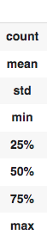
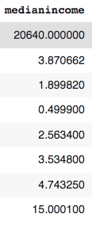
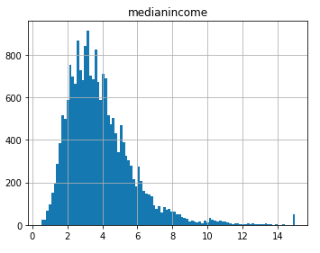
Inference- Median Income
Medianincome variable distribution

Slide 25
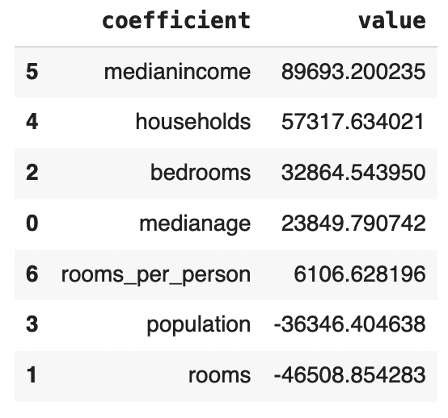
Inference- Rooms per person
Derived variable created- rooms per person
Rooms/person
Methodology: standard scaler, linear regression
Served as an important predictor
Positive predictor values

Slide 26
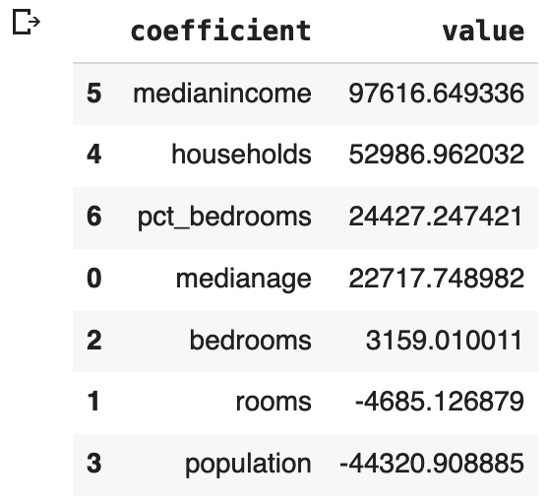
Inference- Non-bedroom rooms
Derived variable created- rooms per person
Rooms/person
Methodology: standard scaler, linear regression
Served as an important predictor
Positive predictor values
Counterintuitive?

Slide 27

Inference- City vs. Suburban/Rural
If we partition the dataset between urban and rural locations, do our relationships hold true? Is this a potential confounding variable, or is its influence already captured by the existing variables?
Methodology: Reverse Geocode API call UDF

Slide 28
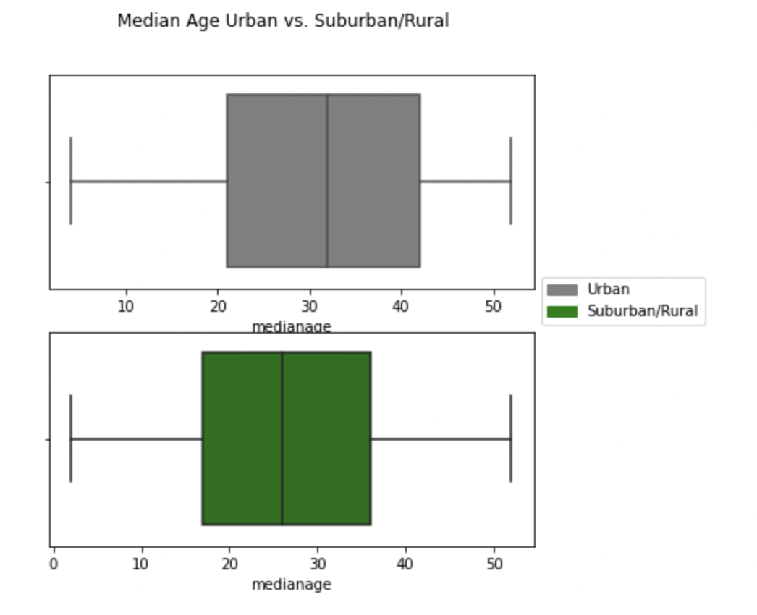
Inference- City vs. Suburban/Rural- Median Age

Slide 29
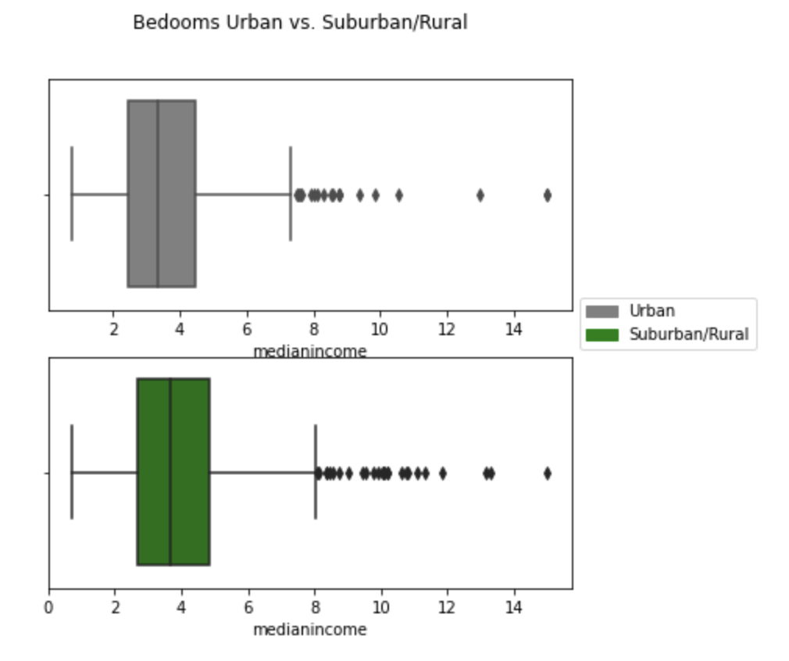
Inference- City vs. Suburban/Rural- # bedrooms

Slide 30
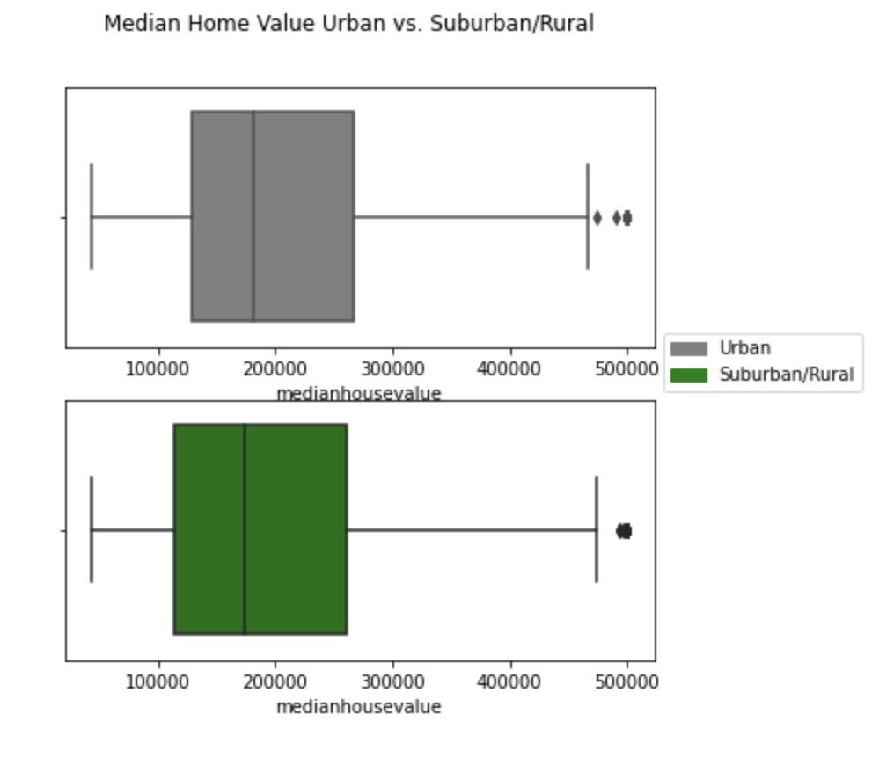
Inference- City vs. Suburban/Rural- Median Home Value

Slide 31
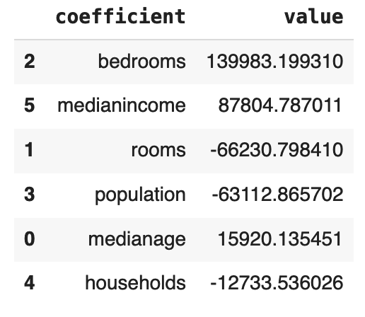
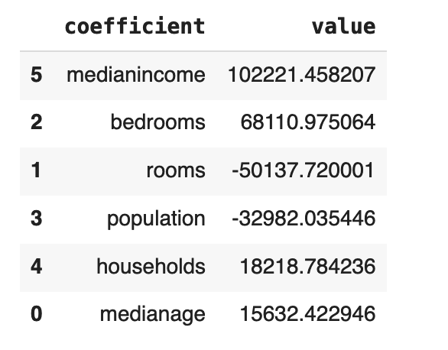
Inference- City vs. Suburban/Rural- Predictor Importance
Urban
Suburban / Rural

Slide 32
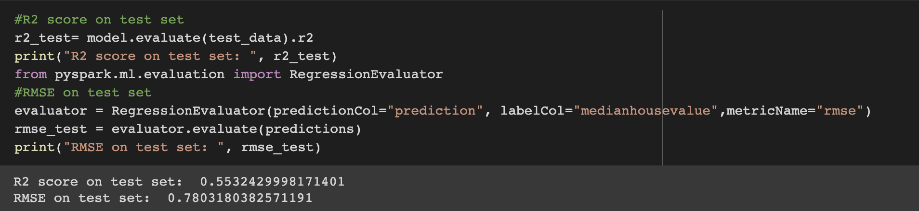
Prediction - Price of an unseen house

Slide 33
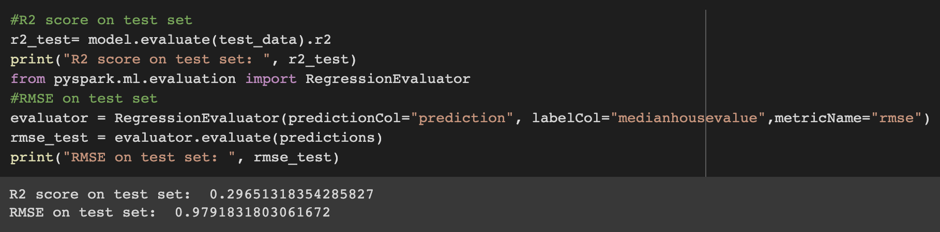
Prediction – Long, Lat, Rooms & Bedrooms
Notes:
The performance of the model isn’t very great. But we can definitely improve the model performance by preprocessing the data even further like removing outliers, transforming the skewed features, feature extraction by principal component analysis etc. We can also play around with the hyperparameters of the model and tune them for a better performance.

Slide 34
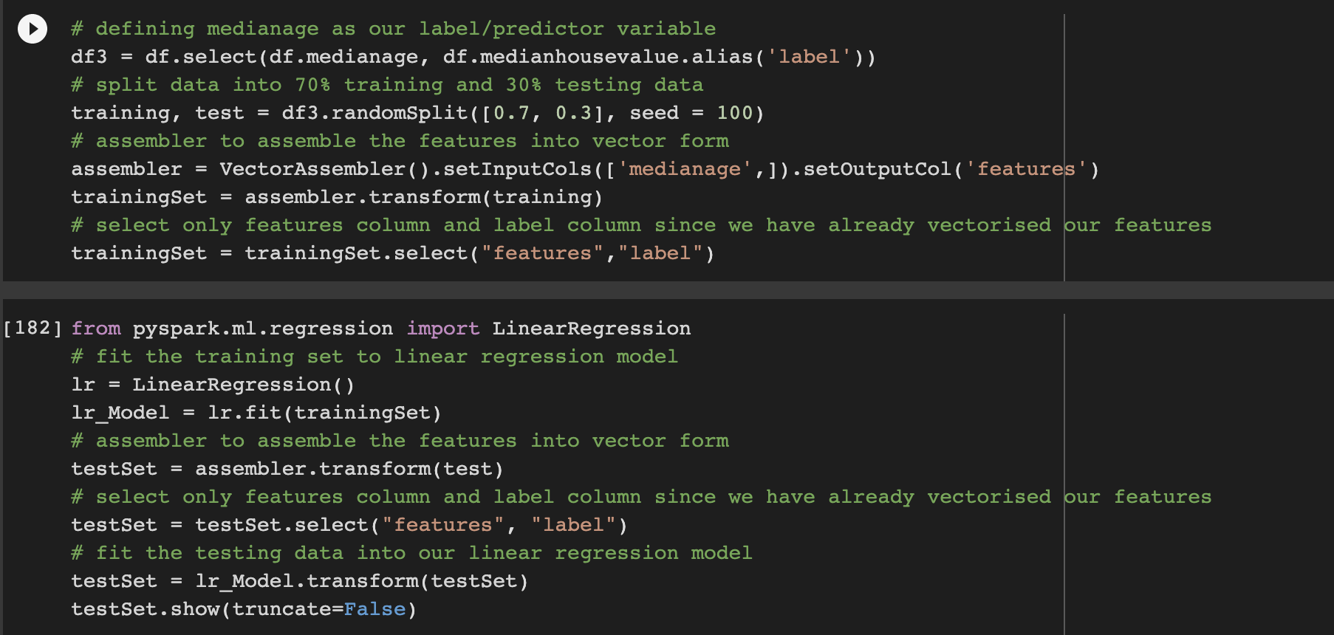
Prediction- Median Age
- R-squared was 0.0122, which shows that median age is not a good predictor by itself.

Slide 35
Project Scope and Overview
Hotel Comparision Analysis| IST-687 Introduction to Data Science in Rstudio
Two datasets to be considered for exploratory analysis.
Analysis focuses on comparison of the two datasets.
The main focus of the analysis will be around Cancellation analysis and revenue analysis.

Slide 36
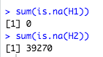
Analyzing the dataset
Both data sets are identical but the data needs to be cleaned.
We check for NA values.
We check for outliers with the help of the hmisc package.
We check for Irregular data in the data columns

Slide 37
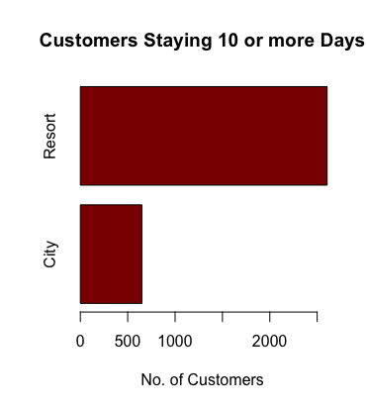
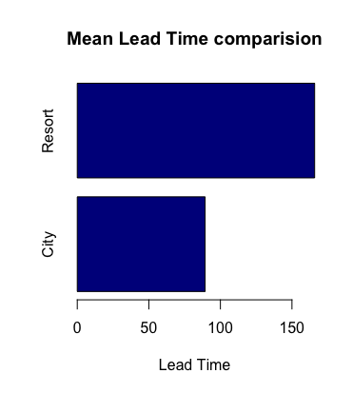
Exploratory analysis

Slide 38
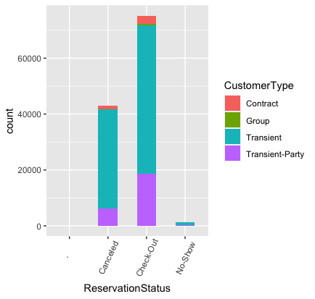
Analyzing by groups

Slide 39
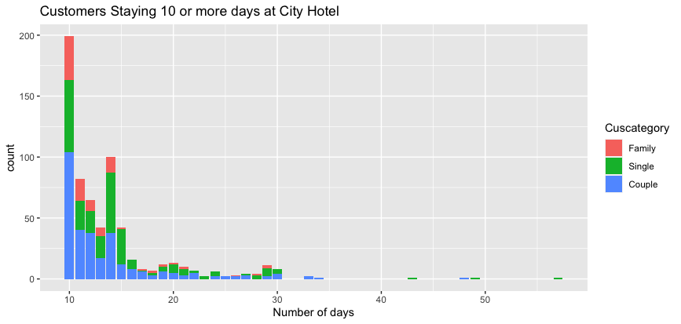
Analyzing by groups

Slide 40
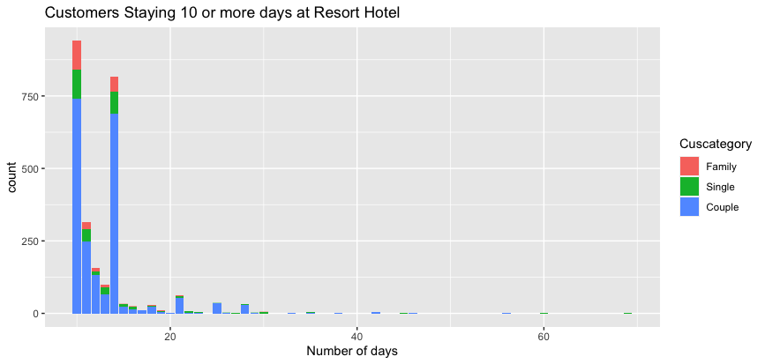

Slide 41
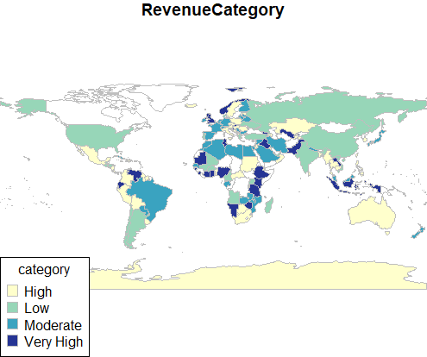
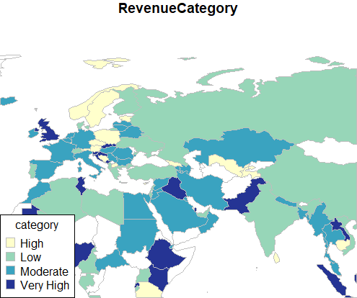
Plotting world maps

Slide 42
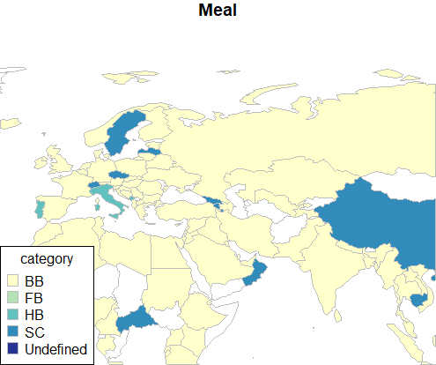

Slide 43
Association Rules Mining
For creating rules we first need to check that the variables under consideration are factors.
We consider the IsCancelled variable on the r.h.s and the factorised variables on the l.h.s
We also create a combined data frame and then conduct revenue analysis with the help of association rules mining.

Slide 44
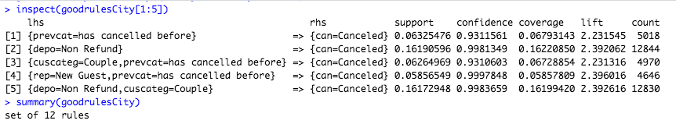
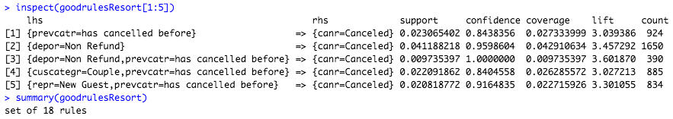
Analysis of Rules

Slide 45
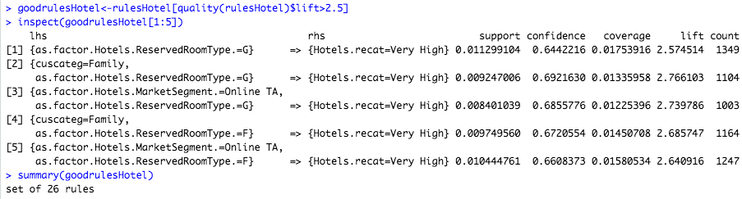
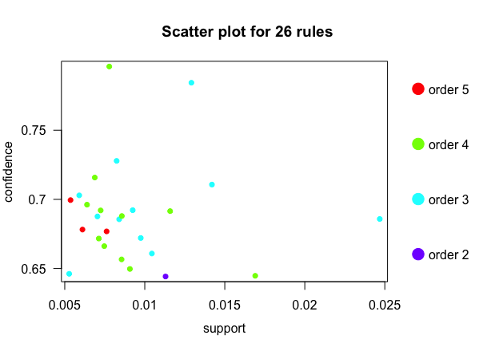
Analysis of Rules

Slide 46
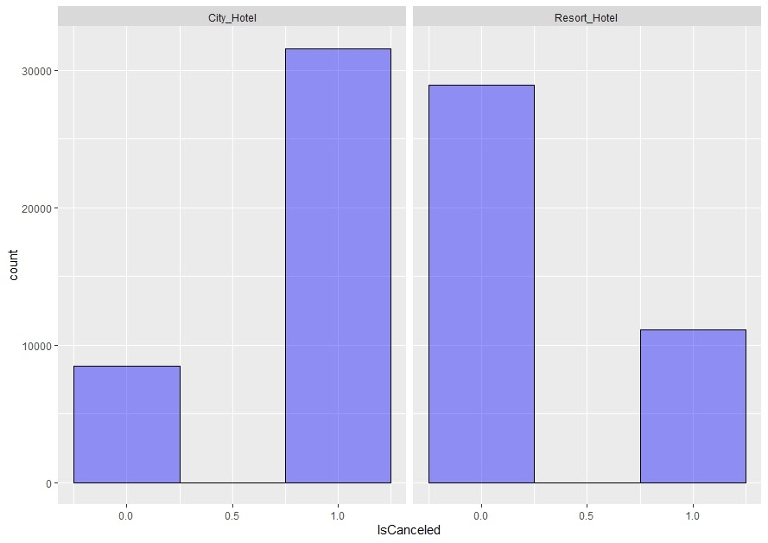
Linear Modeling

Slide 47
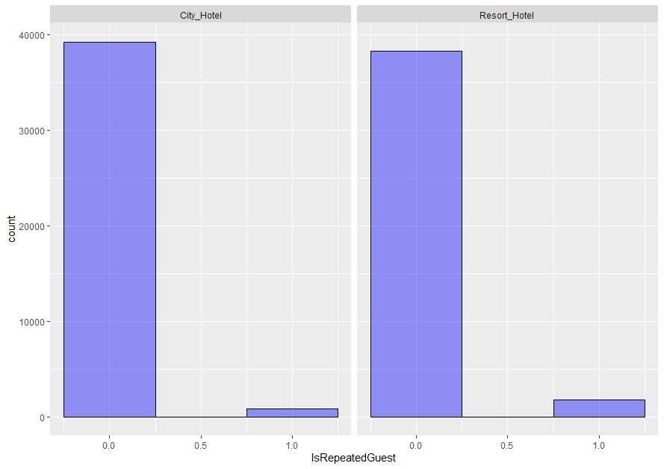
Linear Modeling

Slide 48
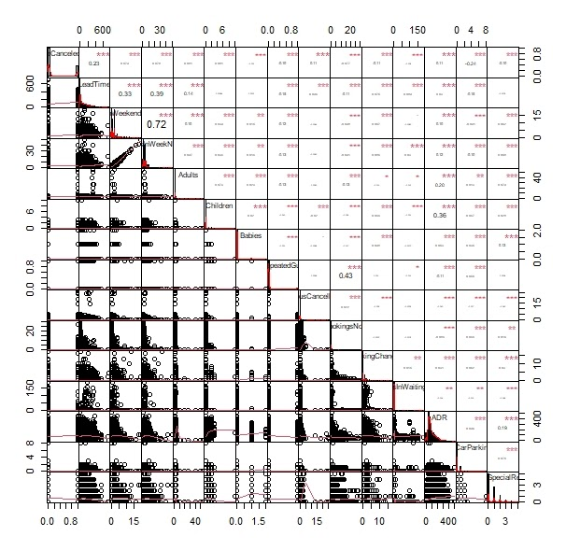

Correlation Coefficients & Graphs for Resort Hotel

Slide 49


Correlation Coefficients & Graphs for City Hotel

Slide 50

Correlation Coefficients for Both Hotels

Slide 51
Linear Model
Call:
lm(formula = IsCanceled ~ LeadTime + CustomerType + Hotel + DepositType +
ADR + RequiredCarParkingSpaces + TotalOfSpecialRequests,
data = Hotels)
Residuals:
Min 1Q Median 3Q Max
-4.8175 -0.3042 -0.1725 0.2801 2.1811
Coefficients:
Estimate Std. Error t value Pr(>|t|)
(Intercept) 1.407e-01 7.052e-03 19.945 < 2e-16 ***
LeadTime 6.890e-04 1.221e-05 56.441 < 2e-16 ***
CustomerTypeGroup -6.297e-02 1.794e-02 -3.509 0.000449 ***
CustomerTypeTransient 1.088e-01 6.503e-03 16.723 < 2e-16 ***
CustomerTypeTransient-Party -4.052e-02 6.858e-03 -5.909 3.46e-09 ***
HotelResort_Hotel -1.796e-02 2.590e-03 -6.933 4.13e-12 ***
DepositTypeNon Refund 5.320e-01 4.173e-03 127.490 < 2e-16 ***
DepositTypeRefundable -8.502e-03 3.175e-02 -0.268 0.788880
ADR 9.281e-04 2.399e-05 38.696 < 2e-16 ***
RequiredCarParkingSpaces -2.787e-01 4.919e-03 -56.656 < 2e-16 ***
TotalOfSpecialRequests -8.882e-02 1.574e-03 -56.440 < 2e-16 ***
---
Signif. codes: 0 ‘***’ 0.001 ‘**’ 0.01 ‘*’ 0.05 ‘.’ 0.1 ‘ ’ 1
Residual standard error: 0.4026 on 119379 degrees of freedom
Multiple R-squared: 0.3049, Adjusted R-squared: 0.3048
F-statistic: 5235 on 10 and 119379 DF, p-value: < 2.2e-16
> lmCanceled$predict <-predict(lmCanceled)
> p = mean(lmCanceled$predict)
> p
[1] 0.3704163
A Multiple Regression
For IsRepeatedGuest
Adjusted R-squared is 0.21
Prediction Probability 3%
For IsCancled
Adjusted R-squared: 0.3048
Prediction Probability 37%

Slide 52
Thankyou

